Slide 1

Presumed Open Data Data Science Challenge
Feb 2021

Slide 2


Presumed Open Data Data Science Challenge
Forecast
Solar
Optimise
Battery
Weather
DATA
Forecast
demand
Reduce Peak
SUB-STATION Demand

Slide 3
Content
Challenge Scenario / Aim
Tasks, Rules & Dates
Site Details
Data Sets
Constraints
Solution Design
Progress
Next Steps
Appendix 1: Technical Design Templates & References

Slide 4
THE CHALLANGE

Slide 5
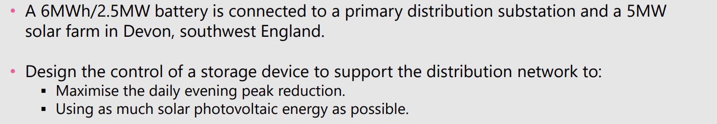
Challenge Scenario
AIM: Reduce Evening Demand over peak (3:30pm to 9pm UTC) via battery discharge. Charge battery before 3pm UTC. Maximise use of Solar.

Slide 6
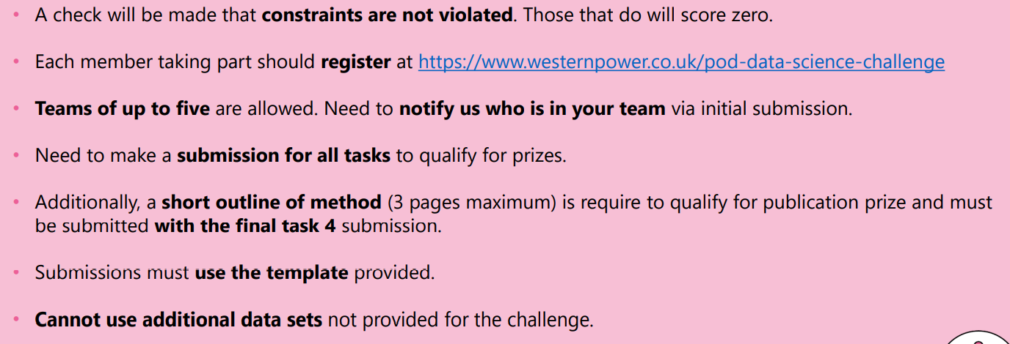
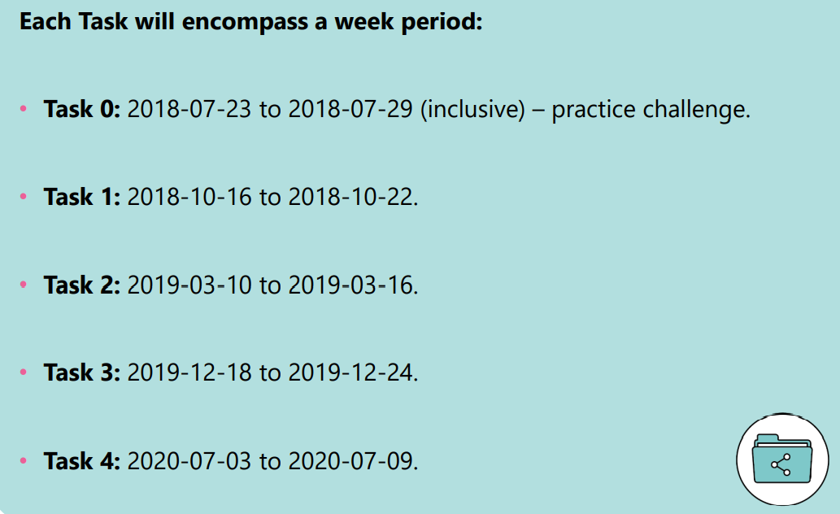
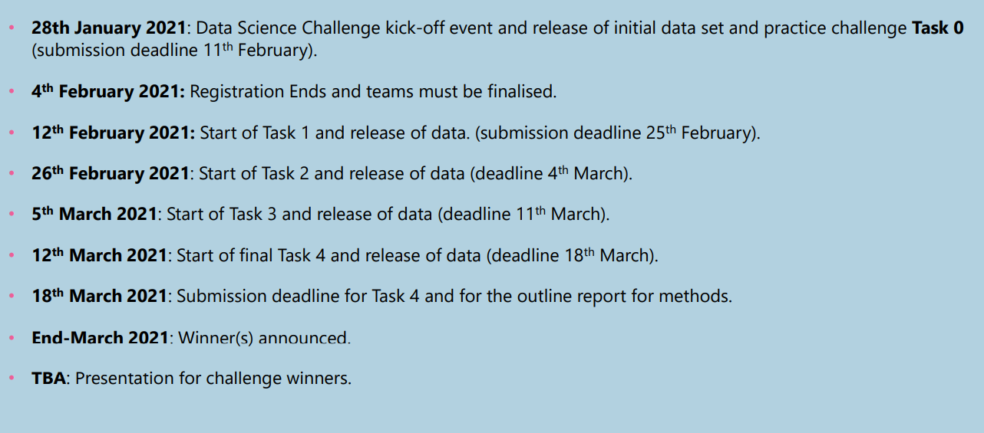
Tasks, Rules & Dates

Slide 7




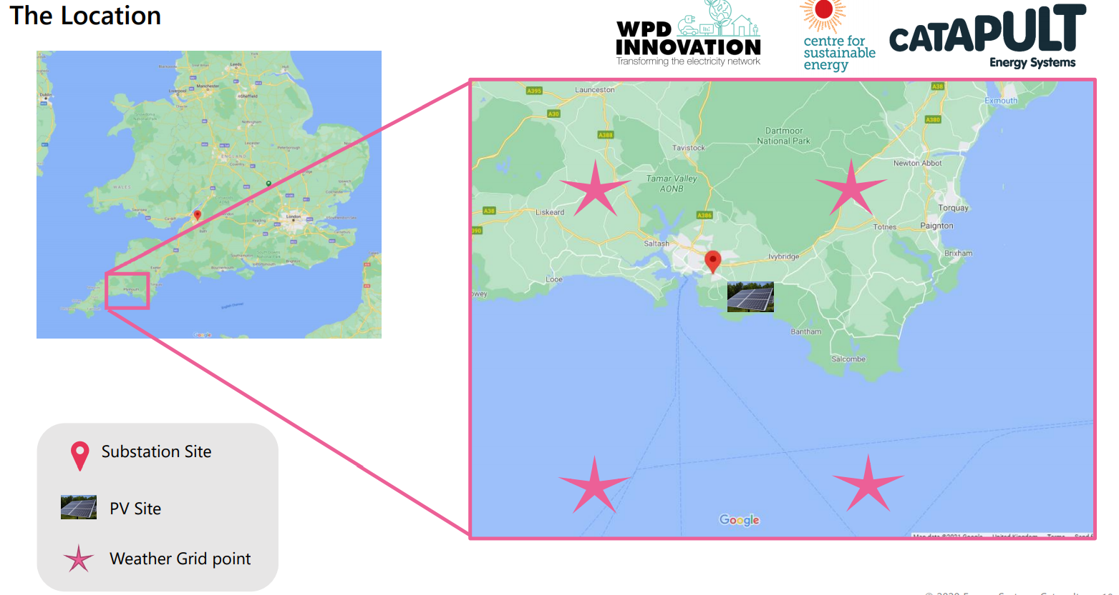
Site Details
Panel Temp
Irradiance
Solar Output
Site Demand = Solar – Battery Charge
Substation Demand
Charge
Discharge
SoC
6MWh / 2.5MW battery
5MW solar farm, Stentaway
Devon, southwest England
Substation
Six weather stations, four near substation / PV – two are in the channel
Temp
Irradiance

Slide 8
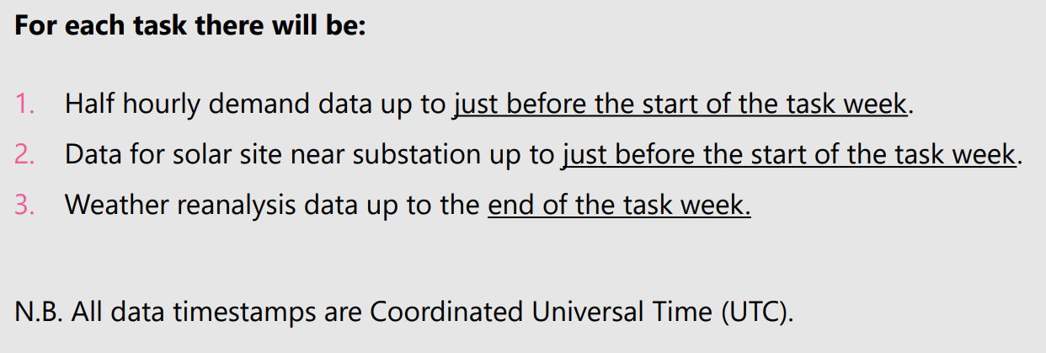
Data Sets
Substation HH Demand: Needs cleaning for Large Values, Constant Values, Missing Values. In UTC but demand follows local pattern. Available up to start of task week.
PV Generation (Needs cleaning for missing values) hh data in UTC for:
Average solar output (MW)
Average irradiance (Wm-2 )
Panel Temperature (Celsius)
Available up to start of task week.
Weather Forecast Data NASA’s MERRA-2
Hourly reanalysis data – i.e. reassimilated forecasts using current observations. ▪ Irradiance (Wm-2 ) ▪ Temperature (Celsius)
Six sites including four surrounding grid points of substation/PV site
Starting 1st January 2015
Up to End of Task Week

Slide 9
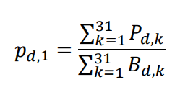
Constraints
Battery Import / Export (2.5MW): −2.5𝑀𝑊 = 𝐵𝑚𝑖𝑛 ≤ 𝐵𝑑,𝑘 ≤ 𝐵𝑚𝑎𝑥 = 2.5𝑀
Battery Capacity (6MWh): 𝐶𝑑,𝑘, (in MWh): 0 ≤ 𝐶𝑑,𝑘 ≤ 𝐶𝑚𝑎𝑥 = 6𝑀𝑊ℎ
Total charge in the battery (State of Charge, SoC) at the next time step 𝐶𝑑,𝑘+1 is related to how much is currently in the battery and how much charged within the battery at time k, i.e. 𝐶𝑑,𝑘+1 = 𝐶𝑑,𝑘 + 0.5𝐵𝑑,
Battery Charging (𝐵𝑑,𝑘 ≥ 0) is only allowed from midnight to 3.30PM (𝑘 = 1 𝑡𝑜 31)
Battery Discharging (𝐵𝑑,𝑘 ≤ 0) is only allowed from 3.30PM to 9PM 𝑘 = 32 𝑡𝑜 42
Battery must start empty at the start of each day in the test week. I.e. 𝐶𝑑,1 = 0 for 𝑑 = 1, … , 7.
Solar generation is always stored first, remainder from Grid:
𝐵𝑑,𝑘 ≥ 0 be the requested power to be charged into the storage device. If 𝑃𝑑,𝑘 𝑇𝑜𝑡𝑎𝑙 is the total PV average power generated by the solar then one of two scenarios occurs:
1. If 𝐵𝑑,𝑘 ≤ 𝑃𝑑,𝑘 𝑇𝑜𝑡𝑎𝑙, then all the energy comes from the solar generation.
2. If 𝐵𝑑,𝑘 > 𝑃𝑑,𝑘 𝑇𝑜𝑡𝑎𝑙, then 𝑃𝑑,𝑘 𝑇𝑜𝑡𝑎𝑙 is stored in the battery from solar generation and 𝐵𝑑,𝑘 − 𝑃𝑑,𝑘 𝑇𝑜𝑡𝑎𝑙 comes from the grid.
proportion of this energy over the day is given by:

Slide 10
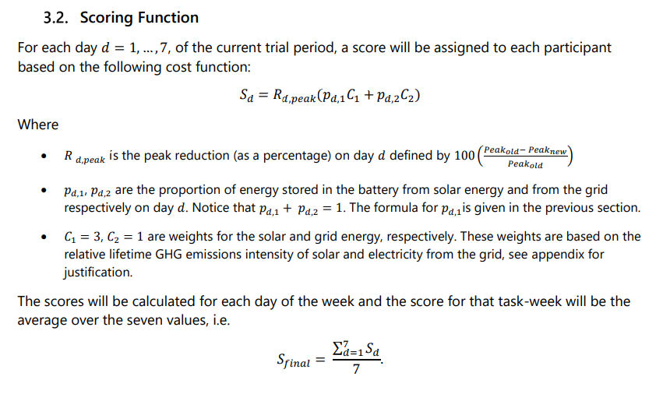
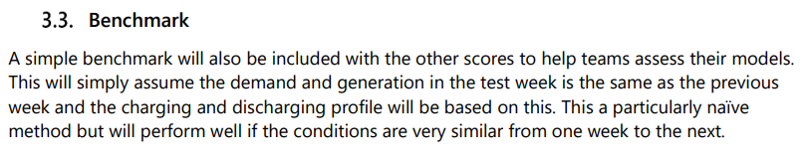
Scoring Function
Reduce Peak Demand
Maximise Charging from Solar since it is consider less carbon intensive than charging from Grid

Slide 11
SOLUTION DESIGN

Slide 12
Solution Functional Scoping
Data Load and Storage
Data Cleansing, Categorisation and Enrichment
Solar Forecasting
Demand Forecasting
Battery Optimisation
Results Storage
Results Validation
Self Scoring
Data Visualisation and Exploratory Analysis
Results Export
Visualise+ Explore Source Data
Visualise+ Explore Forecast Data
Visualise+ Explore Optimisation Results
MODEL BACK TEST
RESULTS VALIDATION
SELF SCORE
Historic Demand
Raw Data Store
DEMAND FORECAST MODEL
Battery Optimisation Solver
Historic PV
Data Cleanse
Store Forecasts
Store Optimisation Results
Weather Forecast
PV MODEL
Asset Static Data - Battery
Asset Static Data - PV
Weather Station Locations

Slide 13









Technical Design
Task Files
Weather
PV
Demand
Enrichment Files
OPTIMISATION SOLVER
(ITERATIONS TO AUTOMATE)
Calendar
Prep Scripts
Asset Static
Data Merge
Demand Forecast
Model
PV Forecast
Model

Slide 14
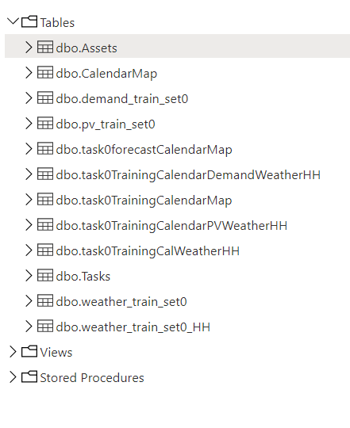
Database Design
Asset
Asset ID*
Name
Location Name
Location Long
Location Lat
Type (BATTERY, SOLAR, SUBSTATION, WEATHER STATION
Capacity MWh
Power MW
Created Date
Created By
Calendar
dateTimeUTC
Clock changes
Mapping to Local
Settlement Period Mapping
List by weeks
WD / NWD
Holidays
Demand Training Data
dateTimeUTC
Demand & PV Forecasts
dateTimeUTC
DemandMW
Otpimisation Results
PV Training Data
dateTimeUTC
PV Forecasts
dateTimeUTC
Weather Training Data
dateTimeUTC
Weather Forecast
dateTimeUTC
Task List
Task
From Date
To Date

Slide 15
IMPLEMENTATION
Task 0

Slide 16
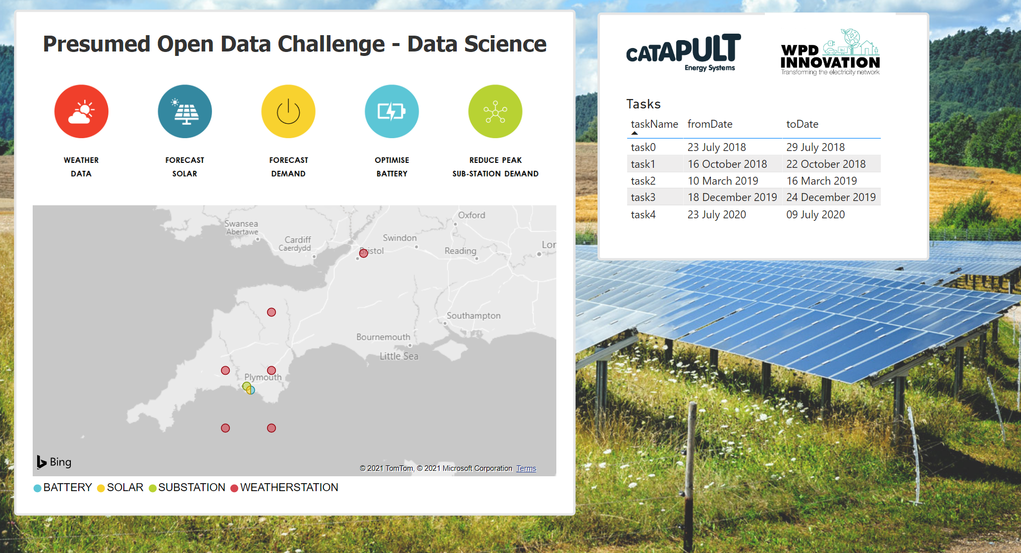

Slide 17
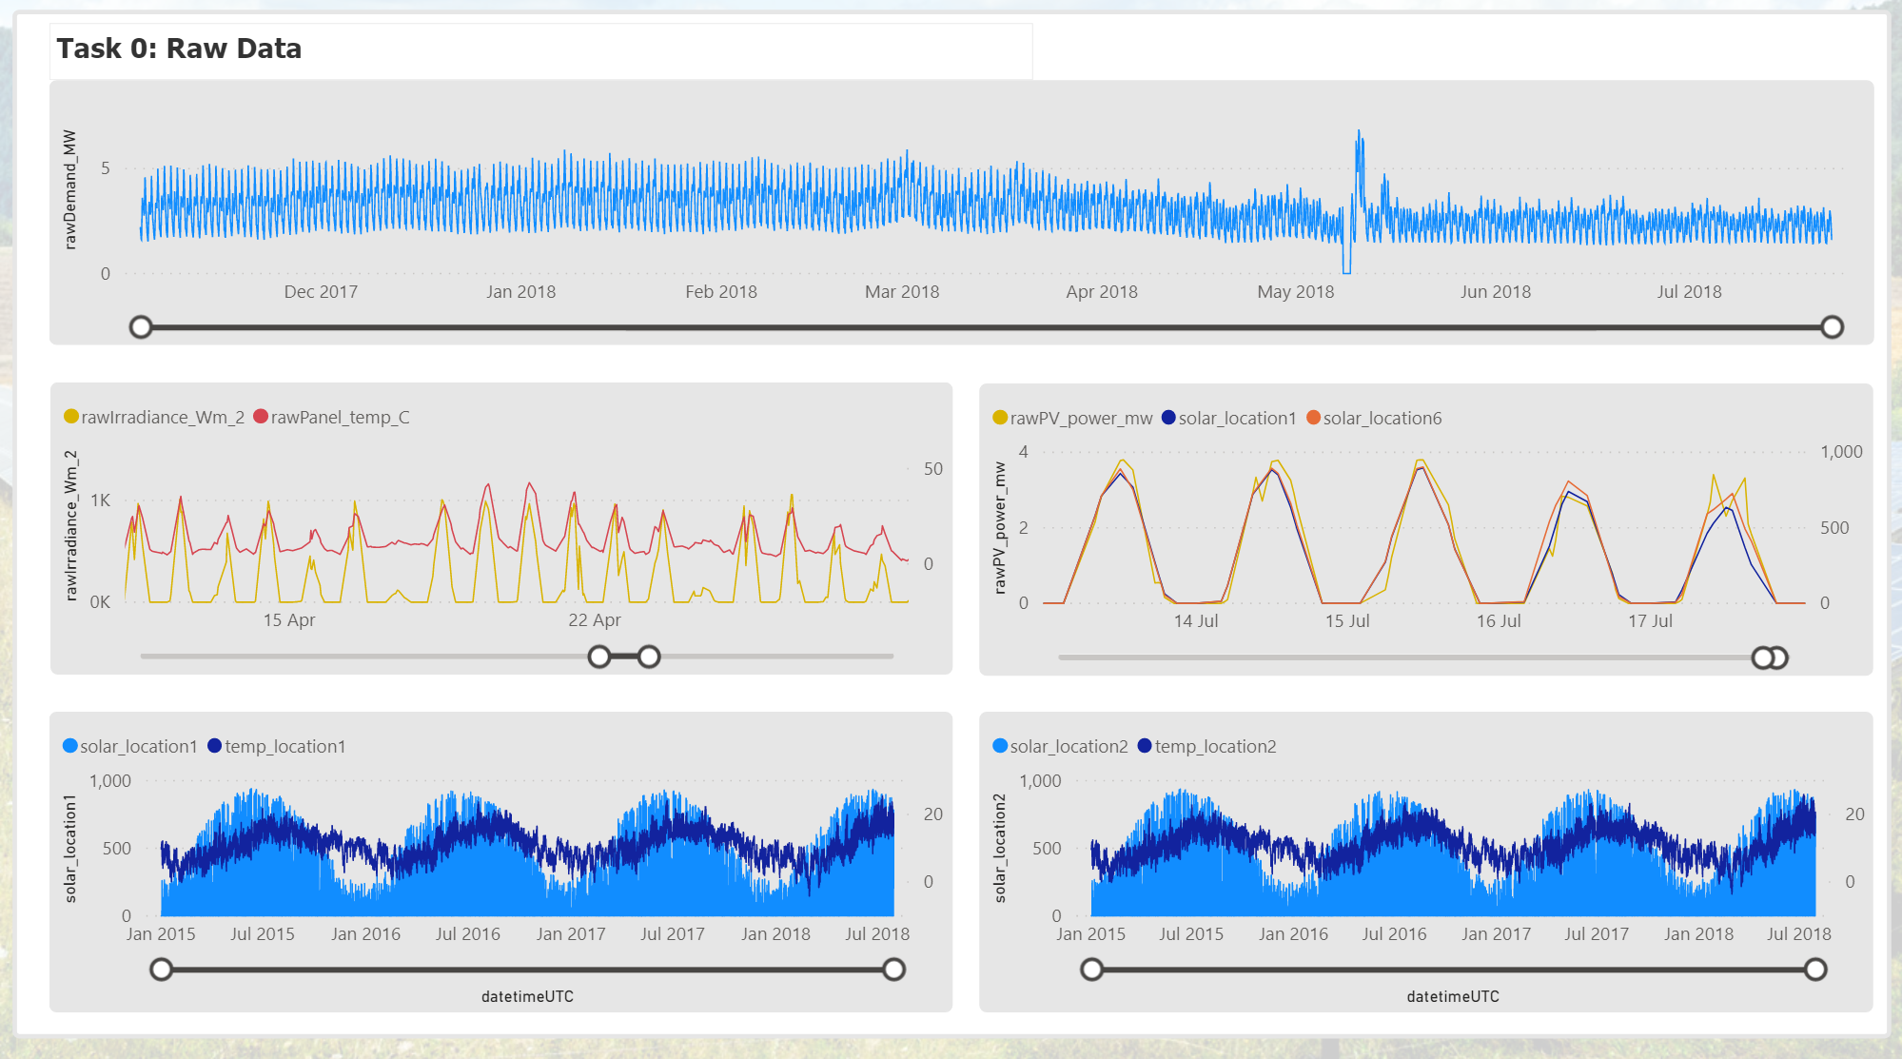
Obvious data errors for cleaning

Slide 18
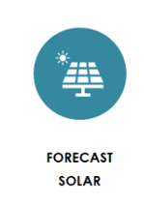
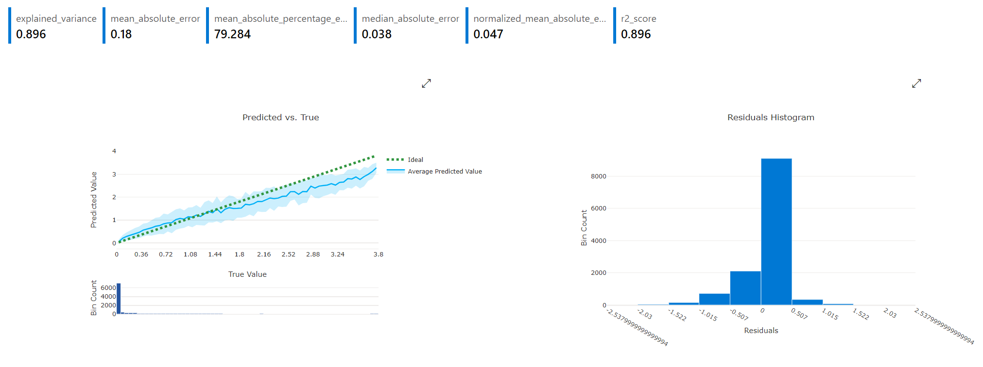
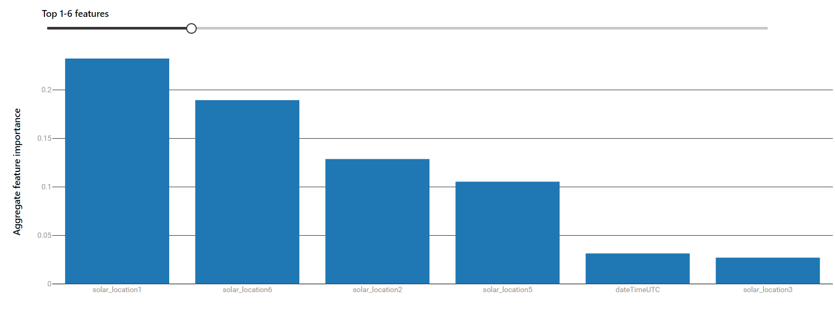
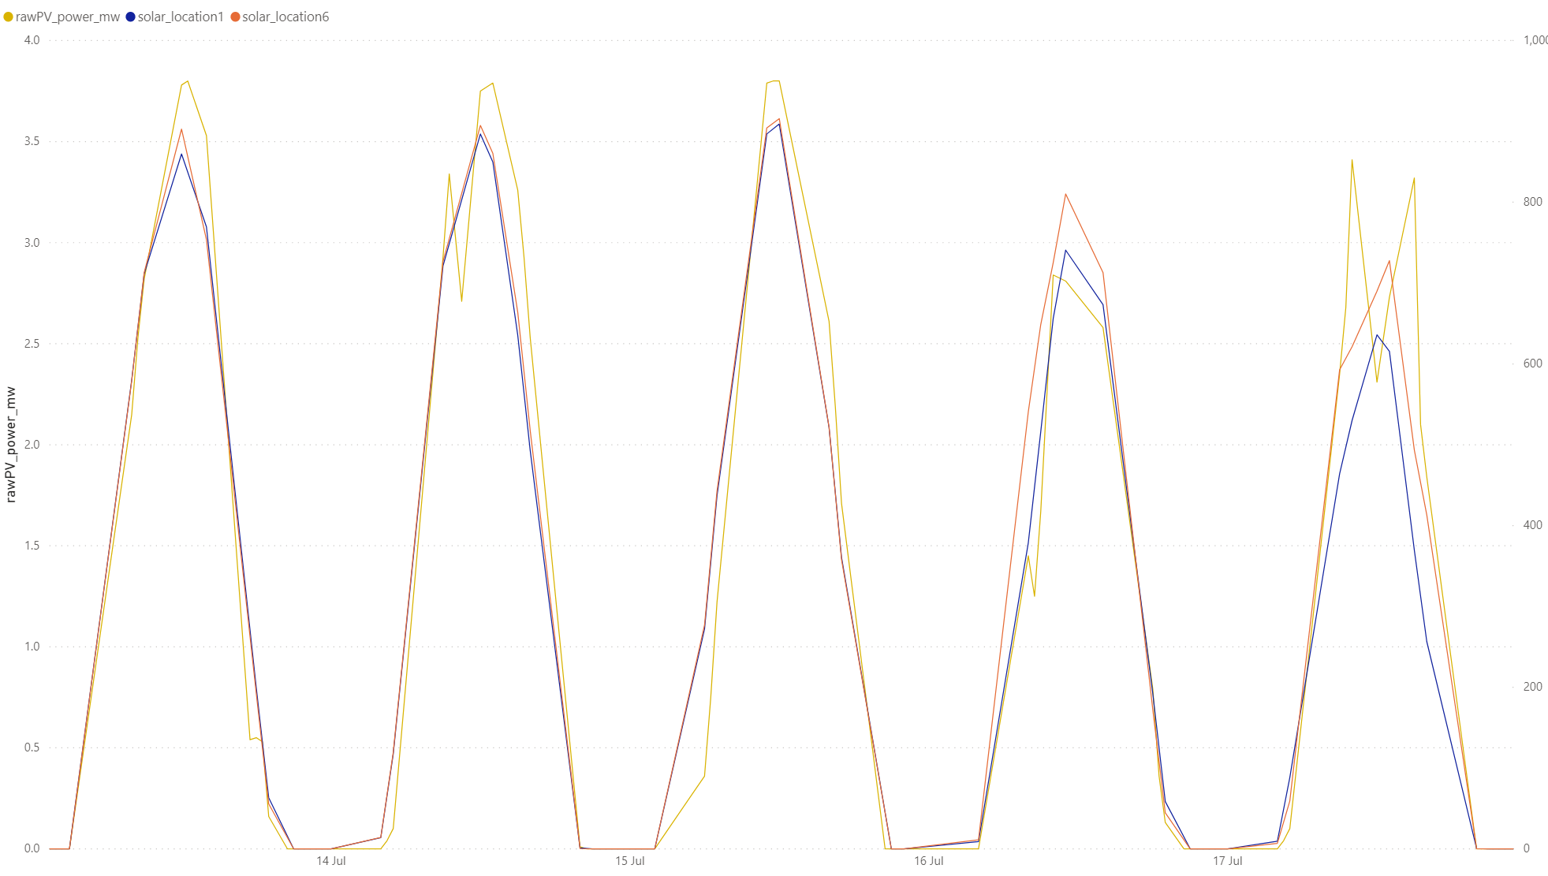
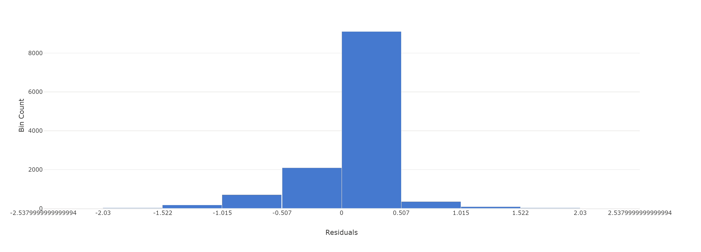
Solar Forecast Model V1
Location 1 and Location 6 strongest influence on Solar Output
Model tendency to under forecast at high output levels

Slide 19
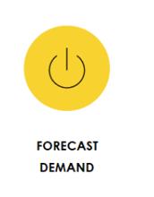
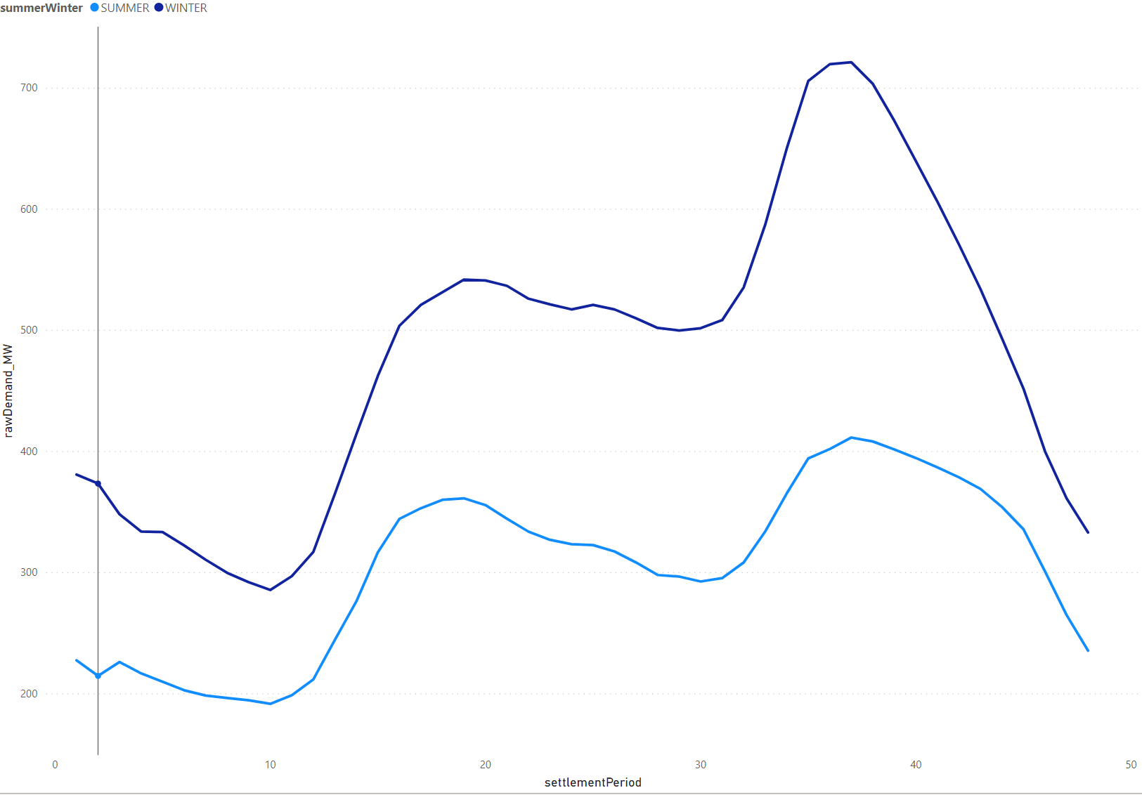
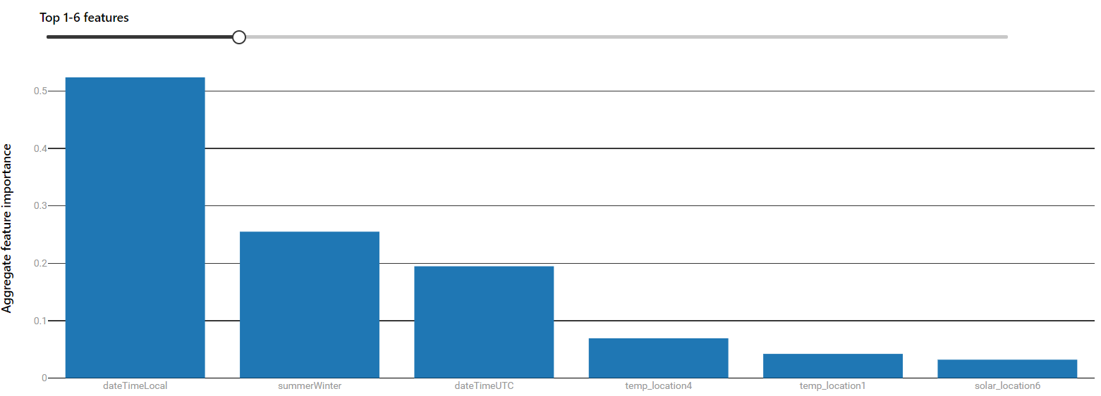
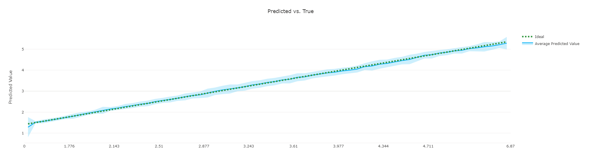
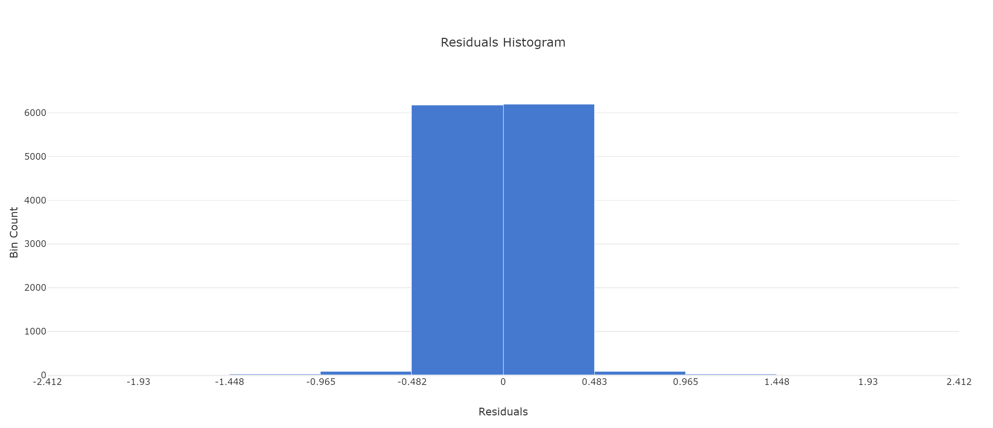
Demand Forecast Model V1
Local Date Time and Season strongest influence on demand

Slide 20

Battery Optimisation V1 – Optimise by Hand
Method:
Limit Solar used from in any half hour period to reflect forecast uncertainty. This is dynamic based on the amount of PV (if we have lots available we can be more defensive on our charging) - PV Risk Factor 1
Limit Solar used in morning, avoid using solar in periods where the output is below a threshold since more likely to be impacted by forecast error – PV Risk Factor 2
Peak Reduction Target is based on average demand for peak hours minus 6MWh in battery, spread battery discharge to flatten peak hours – Target Peak
In charging period, aim to smooth the new peak to minimise creation of a new strain on the distribution network (not required for challenge) – Peak Smooth Target
In the last half hour before going into the peak, if the battery is not able to fully charge form the PV – top up from Grid HH (k=31) – FromGridMW [ASSUMPTION - One hh is sufficient to fill battery via Grid, may need review for winter months]

Slide 21
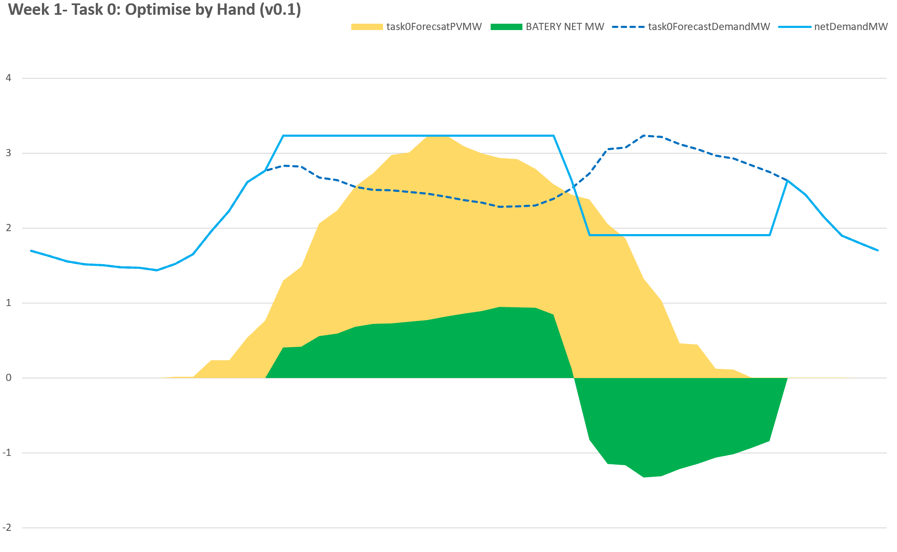
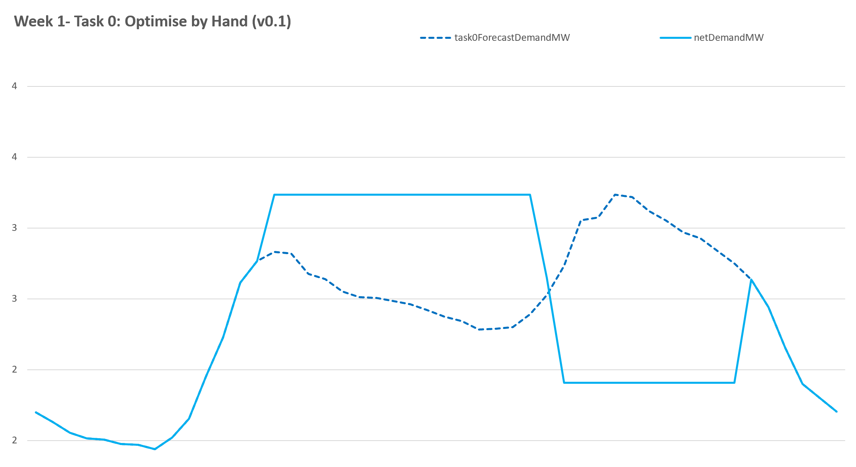
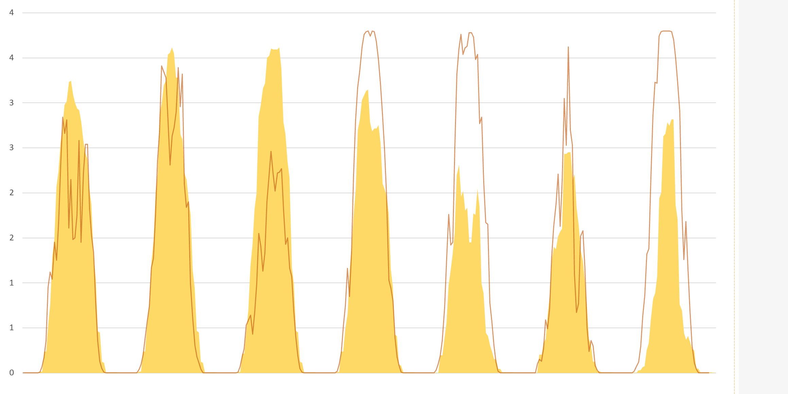
Task 0 – Day 1
PV Risk Factor 2: Avoid using Solar when at low levels if possible
PV Risk Factor 1: Don’t use the full solar output if possible, since hours are predictable but output is volatile
Demand Increase due to Charging
Solar Peak Output unpredictable
Demand Decrease due to Discharge

Slide 22
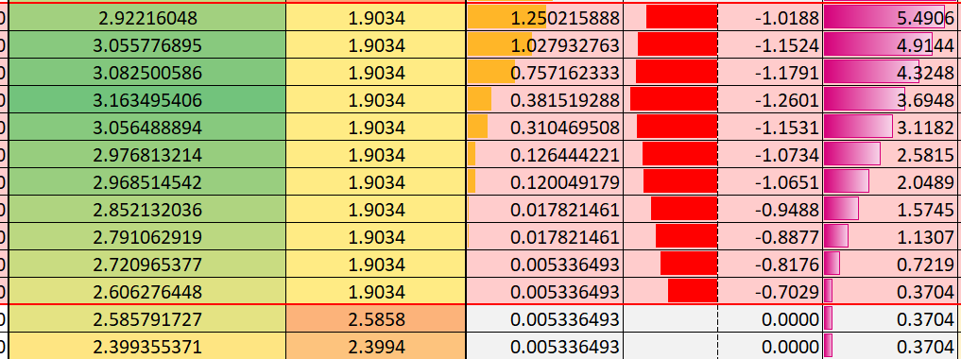
Battery Optimisation V1 – Optimise by Hand
Target Peak Too Aggressive, Battery Empty too early – Last HH is not reduced sufficiently
Manual Model Tunning:
Self Scoring and Constraint Validation Dashboard used to iteratively refine Risk Factors used and optimise score (assuming perfect forecast)
Observation: Tunning of the Risk Factors can lead to;
Not fully charging the Asset from PV going into the peak hours
Not fully discharging the Battery into the peak, sub optimal peak reduction.
Emptying the battery before the peak is over, leaving the last period as the new peak
Target Peak not aggressive enough, full battery charge not used remains in battery

Slide 23
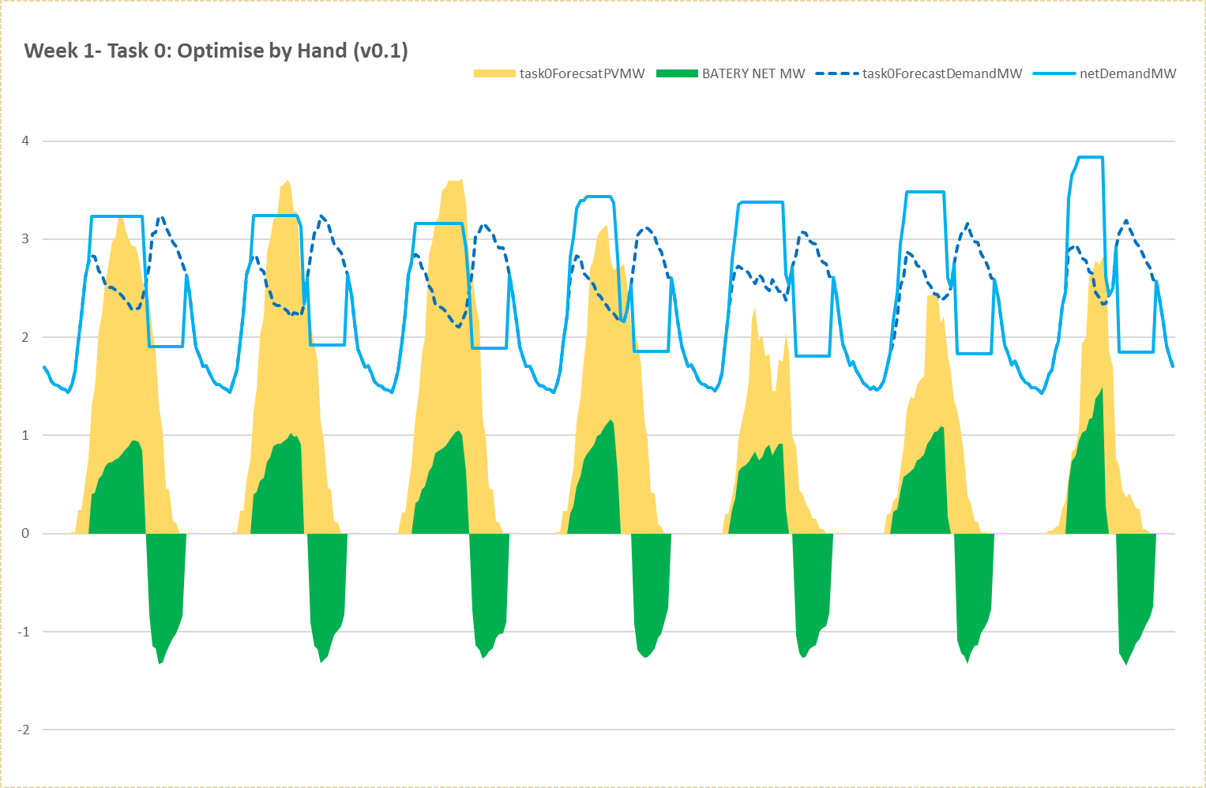
Battery Optimisation V1 – Optimise by Hand
Generally spare solar in peak solar period
Close to using Grid power near solar ramping

Slide 24
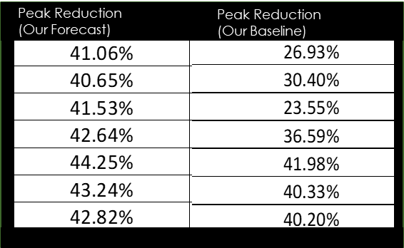
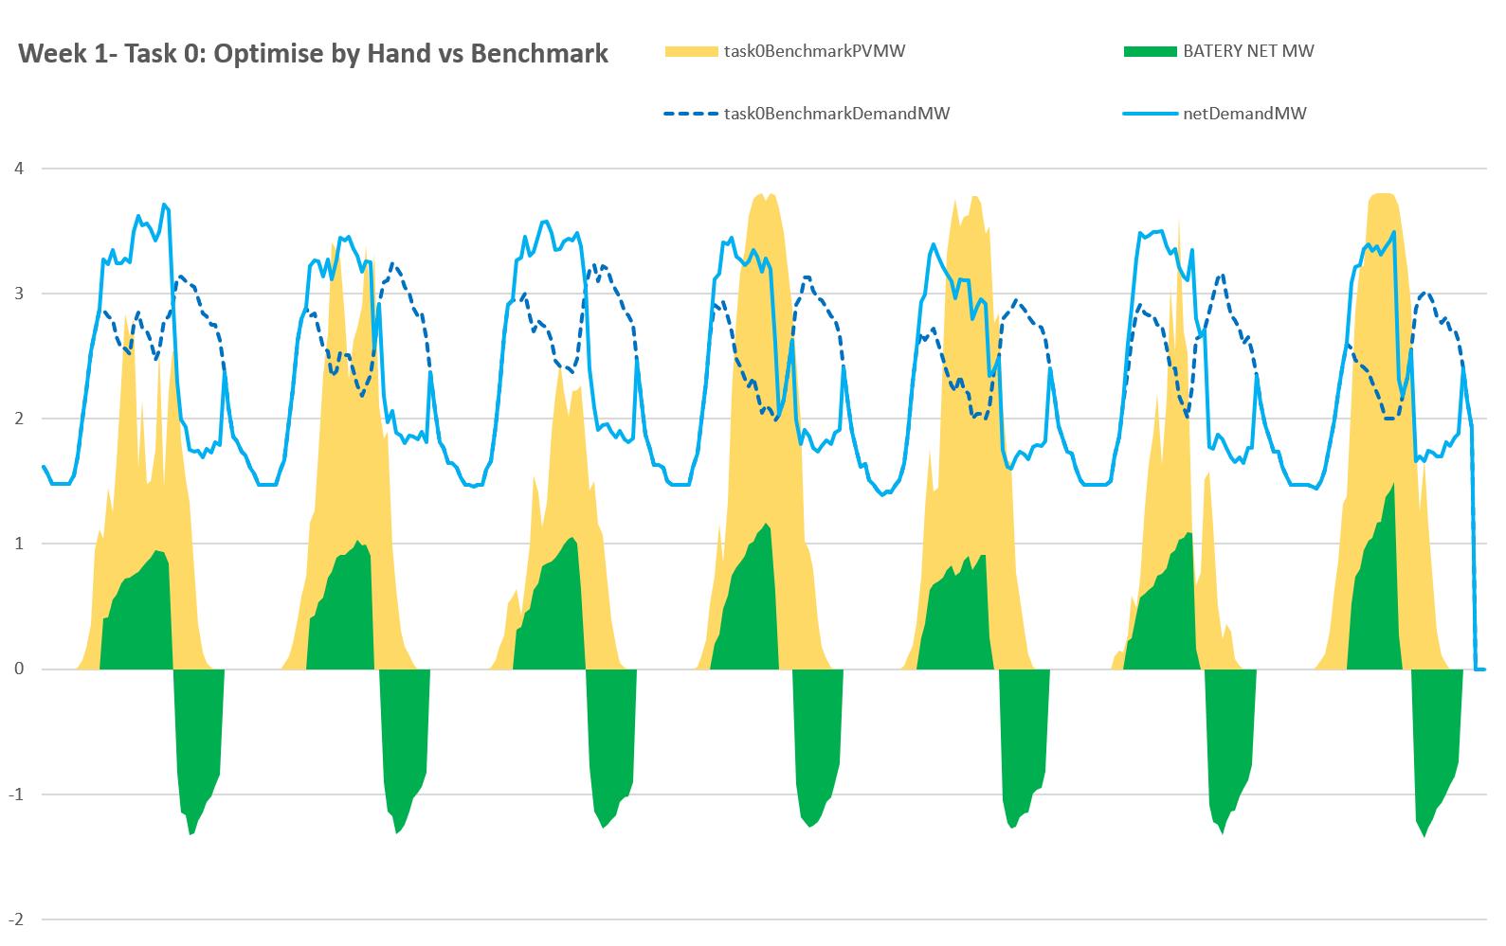
Optimise by Hand Battery Schedule vs Benchmark Forecast
Benchmarking:
Use Task 0 Battery Schedule from Optimise by Hand with ML forecasts of Demand and PV
Score against Benchmark Week (which is the week prior to the Task 0 week – 16-32 July 18)
Observations:
Score for week reduces from 8.89 to 7.199
No periods of using power from Grid, we are close on shoulder periods of Solar ramping
Peak Reduction has reduced from 42% on average to 34%
Can be more aggressive in Charging in Solar Peak
Chance of using Grid power near solar ramping

Slide 25
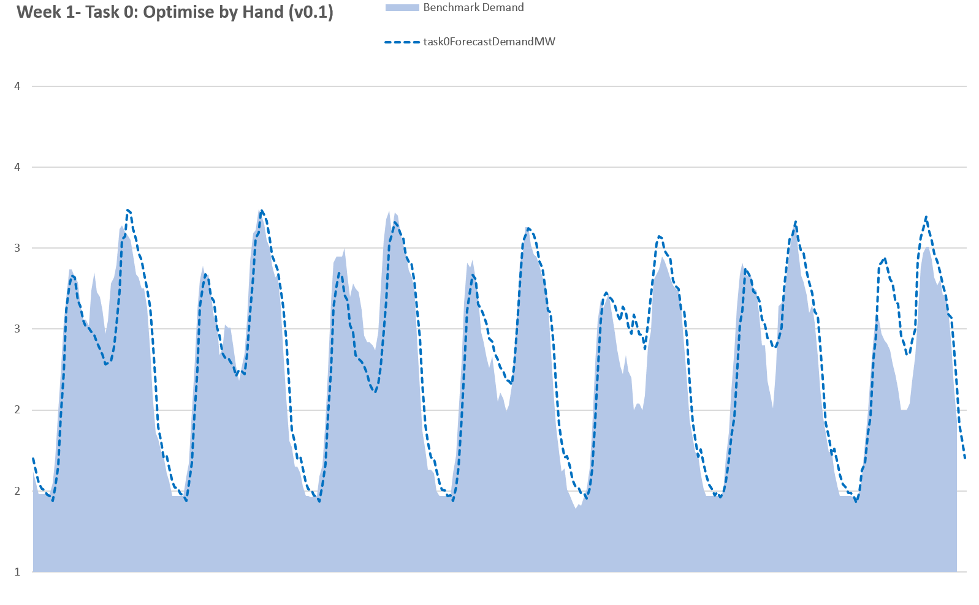
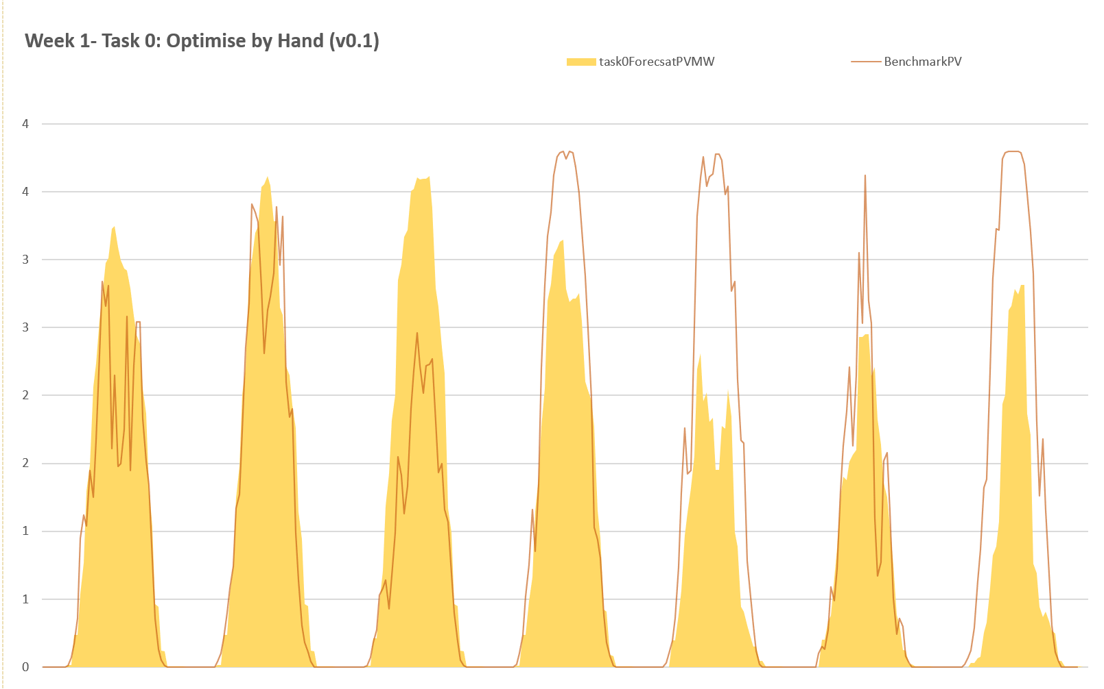
Benchmark Week vs Our Forecast

Slide 26
Task 0 Results
Top 10 in the first week, a decent start!!

Slide 27
Task 1
16/10/2018 – 22/10/2018

Slide 28
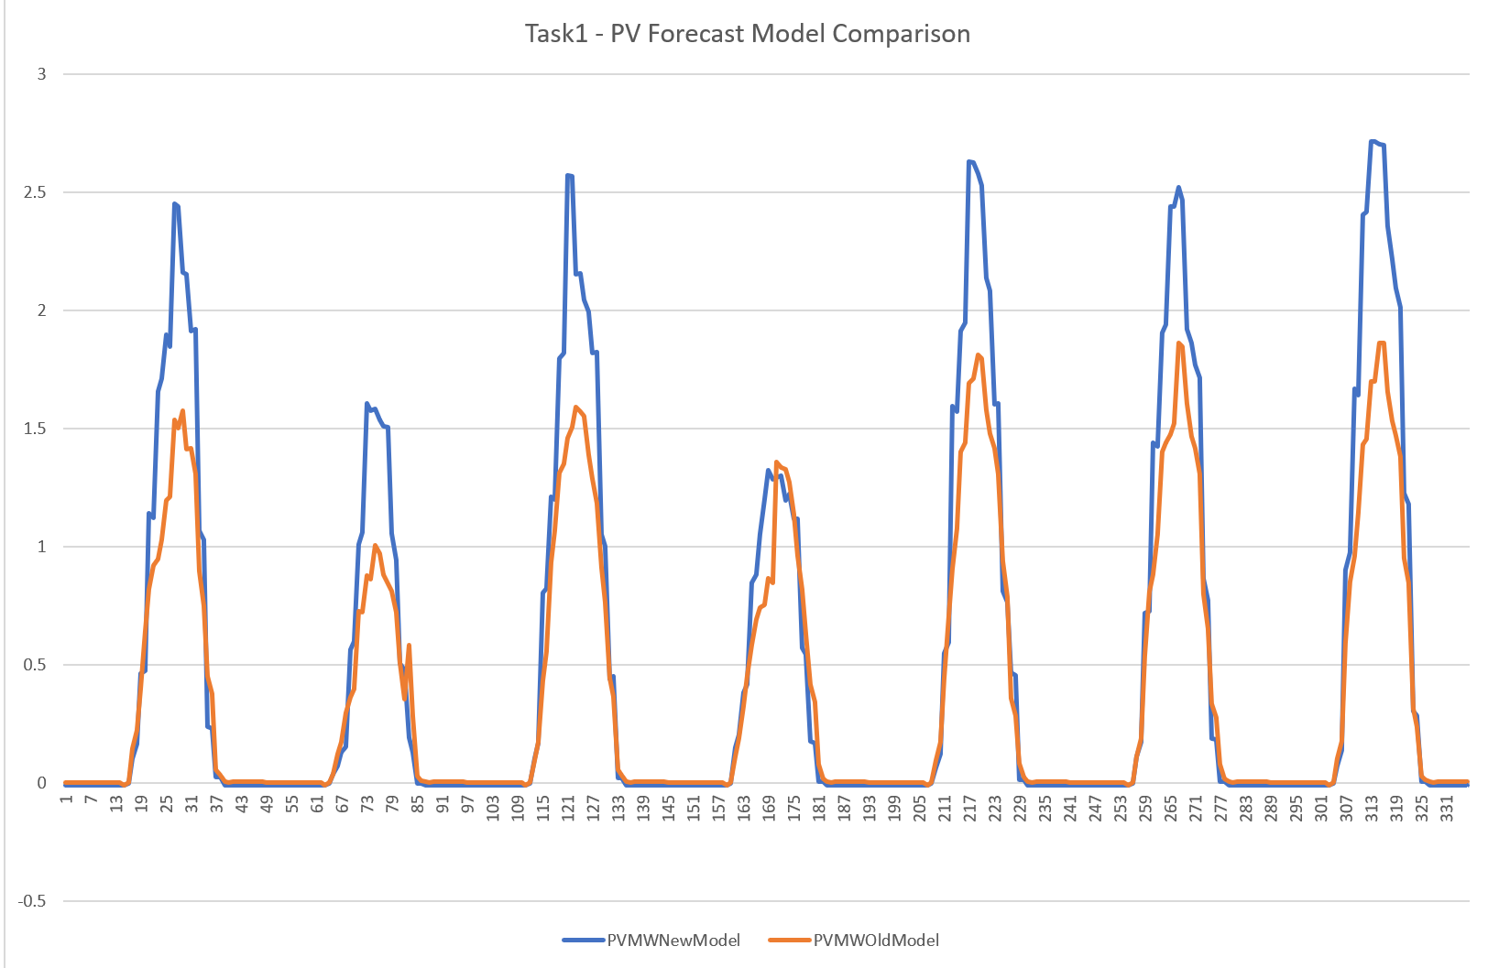
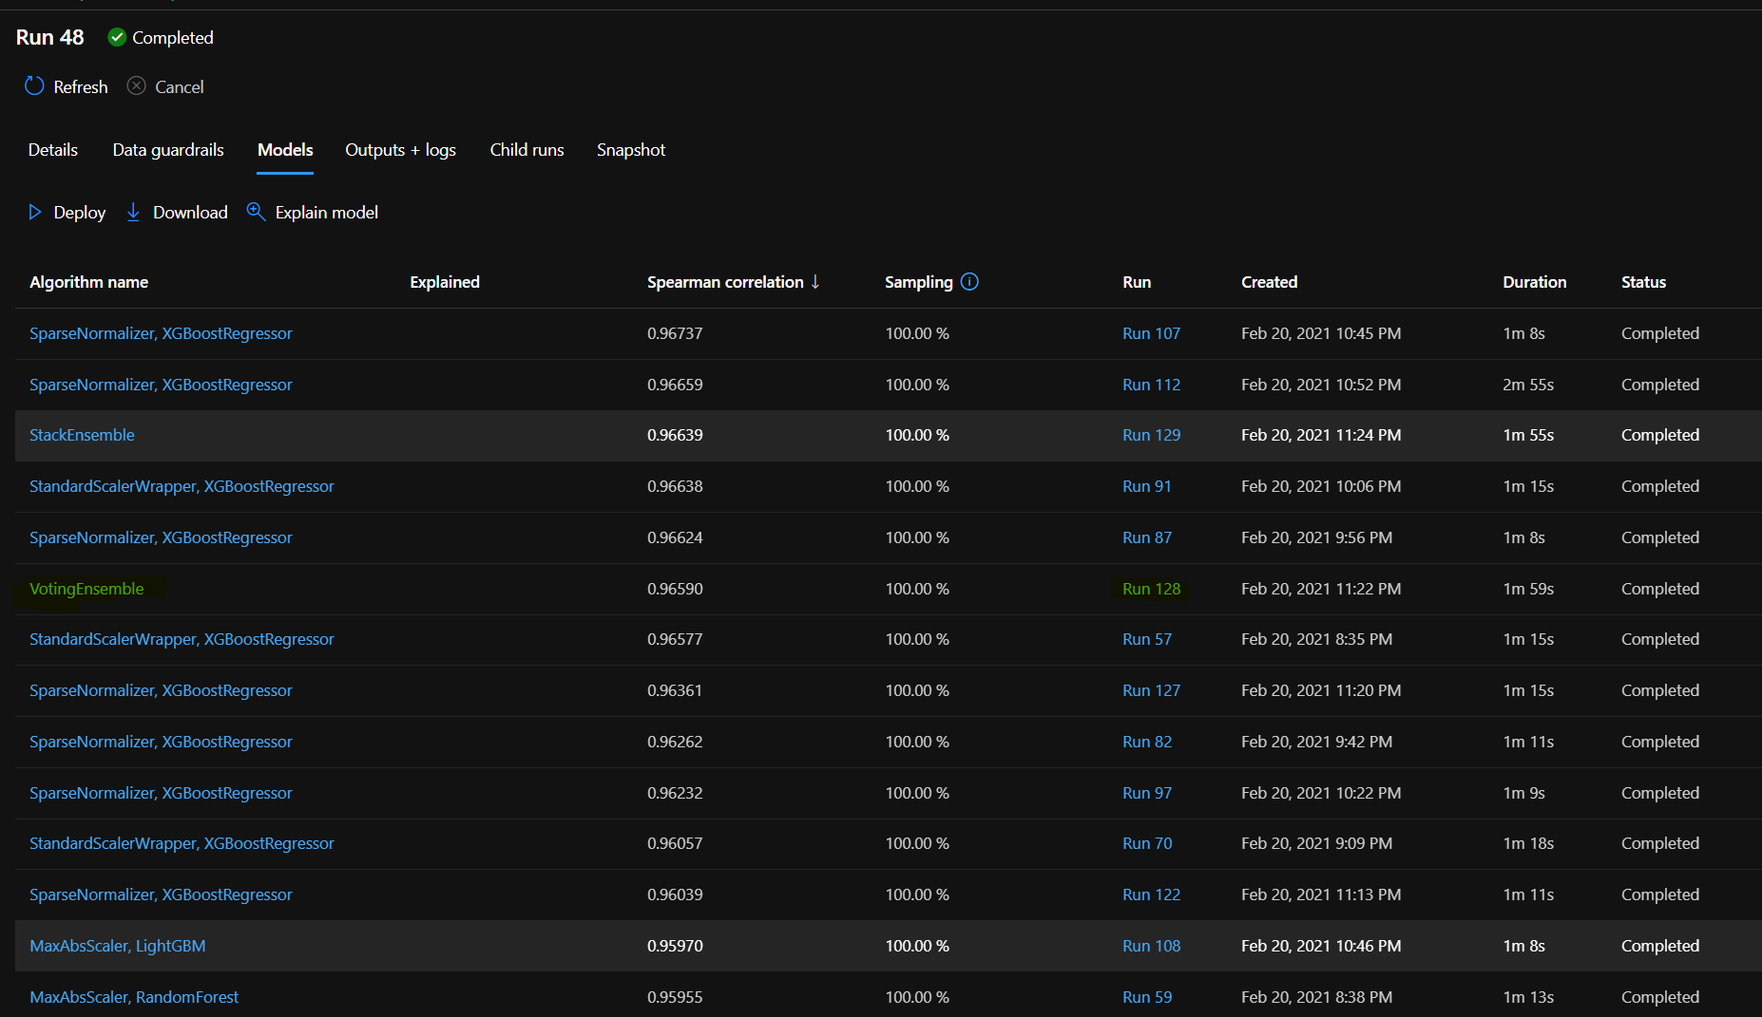
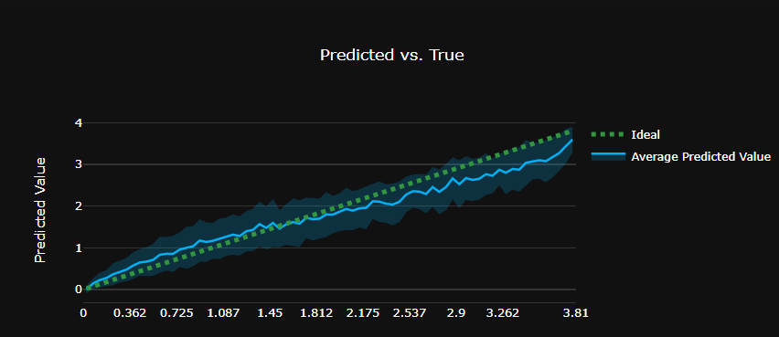
Solar Forecast Model V2
Chosen different model type, Voting Ensemble (instead of recommended SparseNormalizer)
This seems to have less tendency to under estimate at high values vs Task 0 model
Some improvement in match

Slide 29
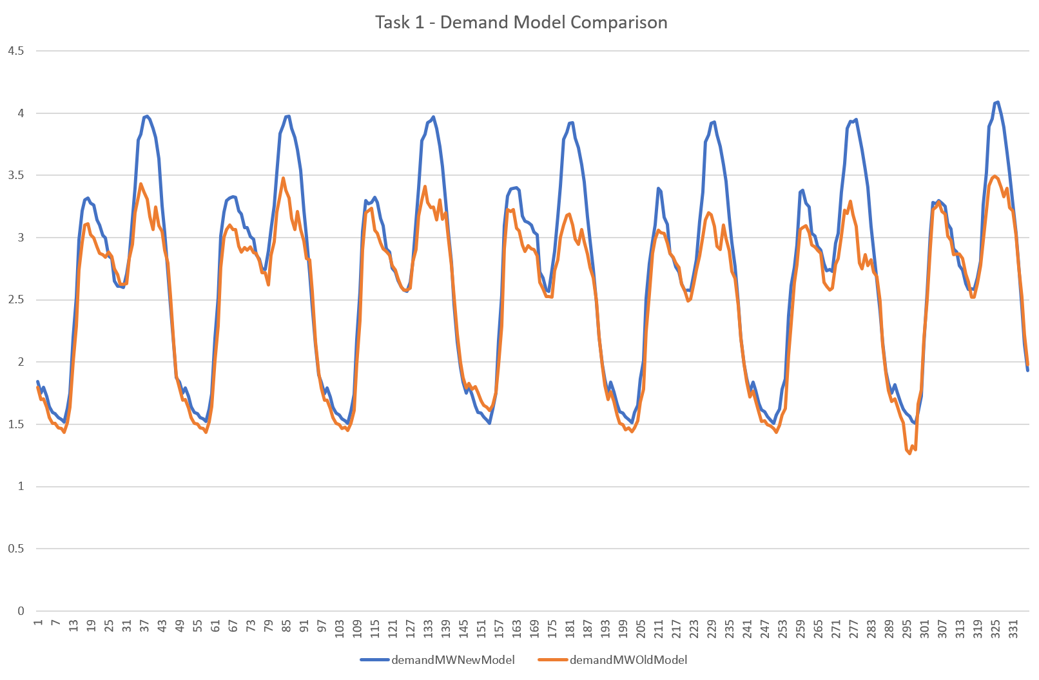
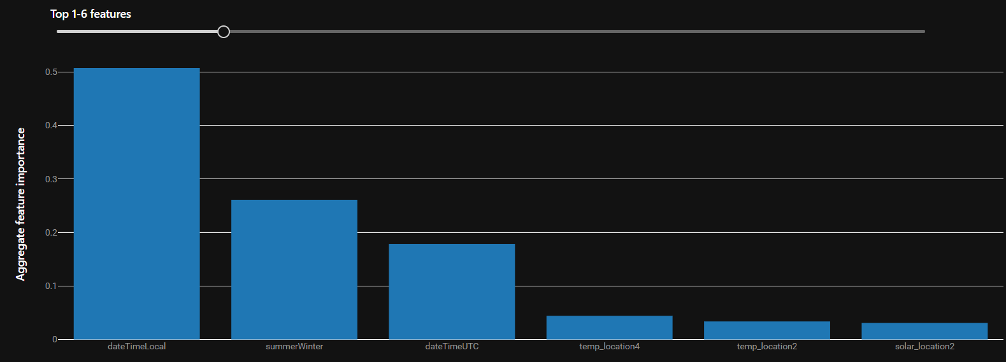
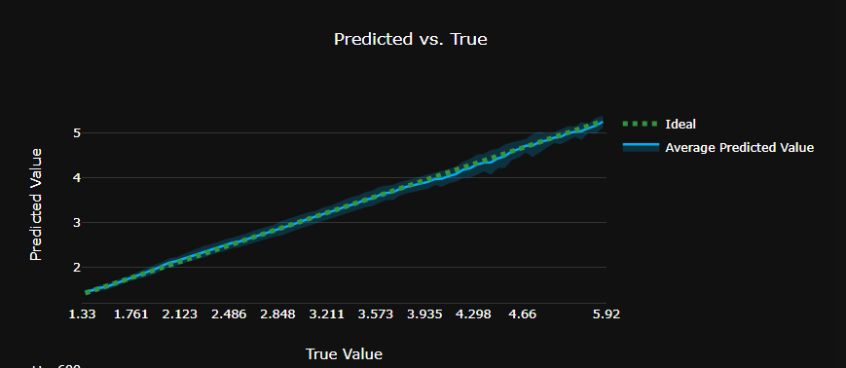
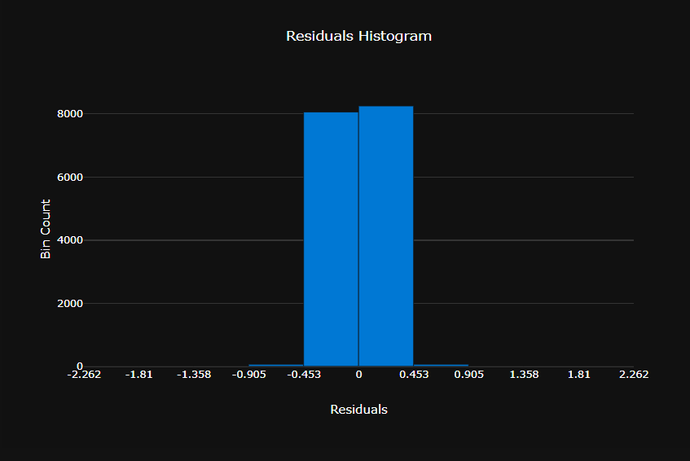
Demand Forecast Model V2

Slide 30
Battery Optimisation V2 – Optimise by Hand
Method Improvements:
Solar Shoulders: Added new parameters for managing solar ramping, allows lower percentage of solar to be used during the solar ramping periods – PV Risk Shoulder Level and PV Shoulder Risk Factor
Corrected Scoring: Scoring now aligned to results, divide by 7 and take as percentage

Slide 31
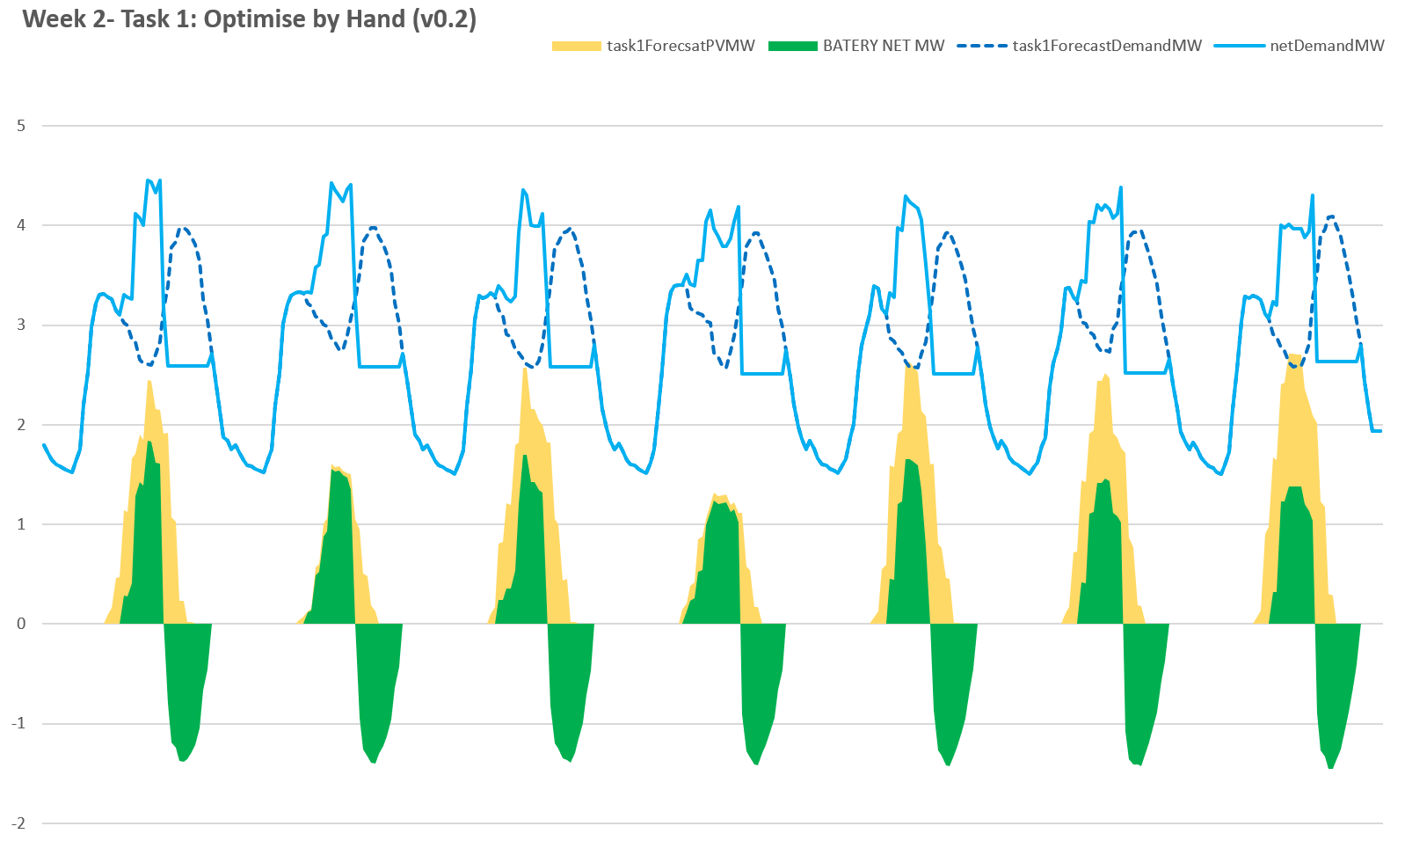
Task 1 Battery Optimisation V2 – Optimise by Hand

Slide 32
Task 1 Results
Significant Drop in league position, from 8th to 25th
First days of task we performed particularly badly

Slide 33
Task 2
2019-03-10 to 2019-03-16

Slide 34
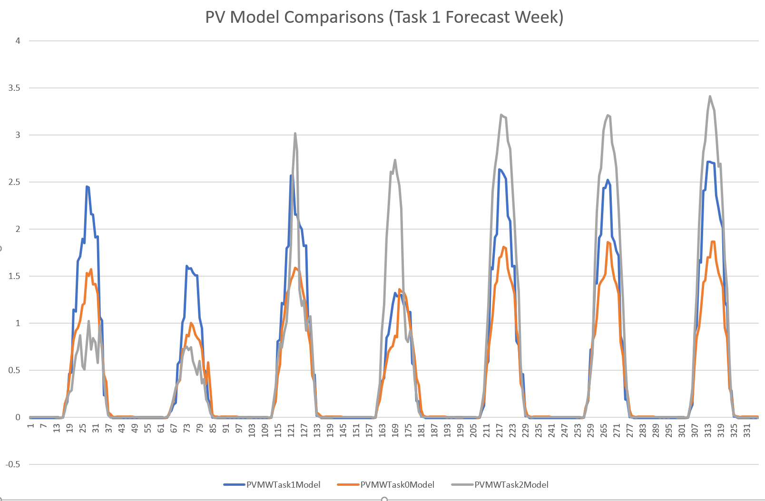
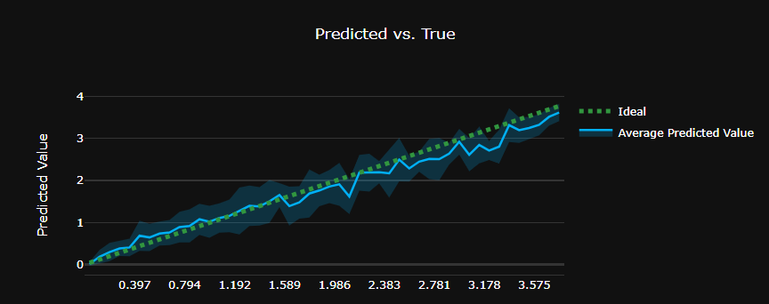
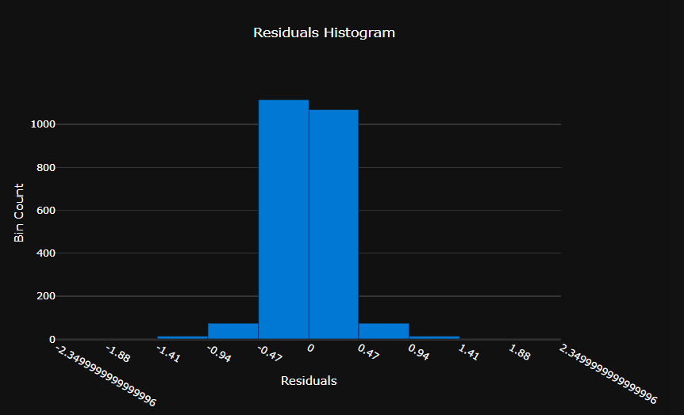
Solar Forecast Model V3
Solar model appears to be improving with extra data

Slide 35
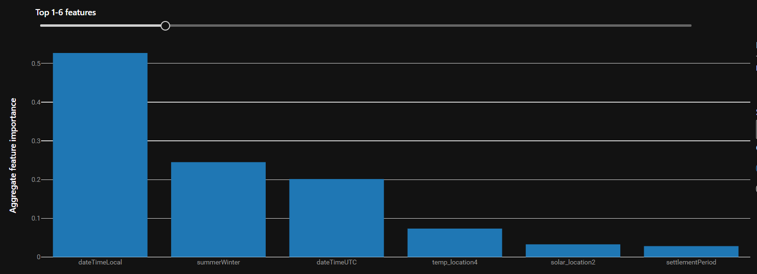
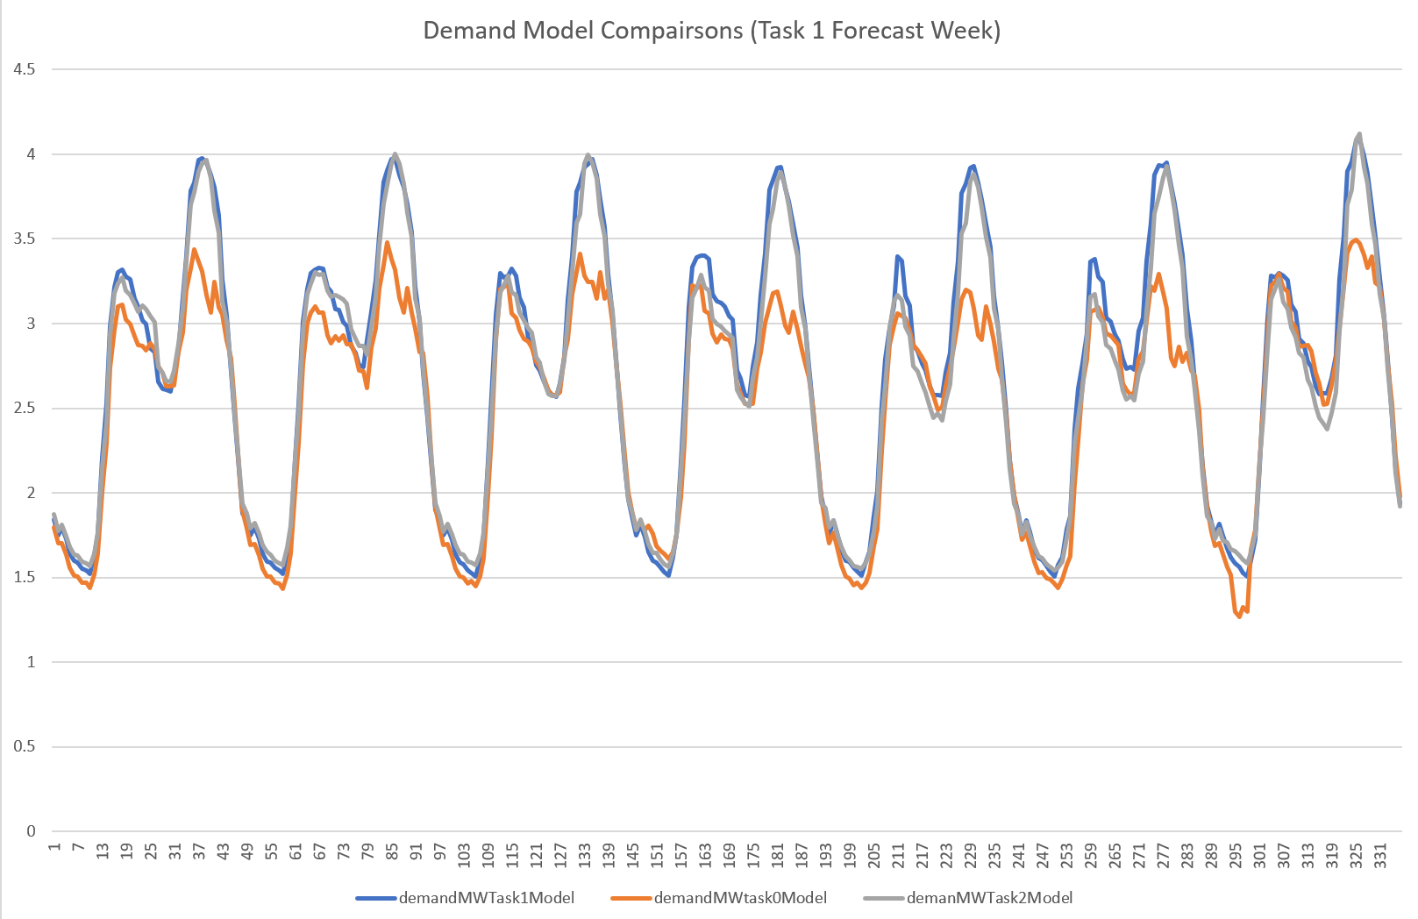
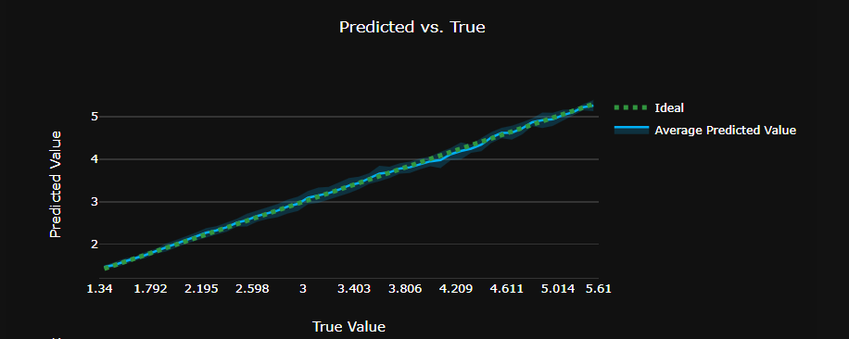
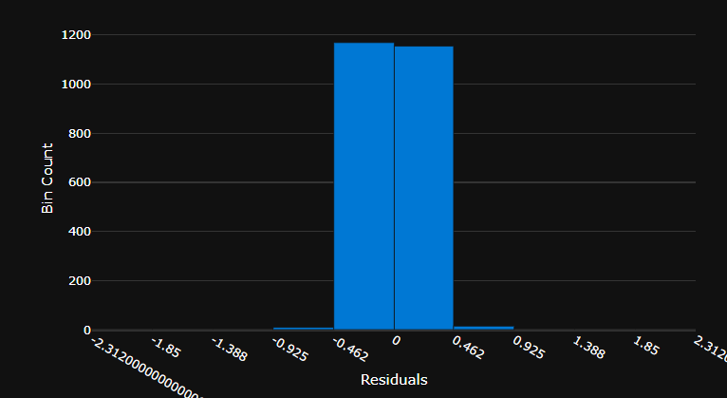
Demand Forecast Model V3

Slide 36
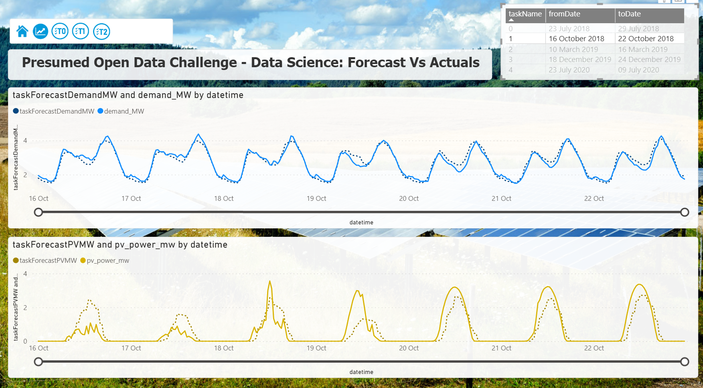
Forecast vs Actual Comparison - Task 1 Week
Poor Task 1 results for days 1-3 explained via Forecast errors in both Solar and Demand
Under Forecast of Peak Demand
Possible 1 hour offset in forecast vs actual
Poor Solar Forecast for days 1 to 3, errors in peaks not shoulders

Slide 37
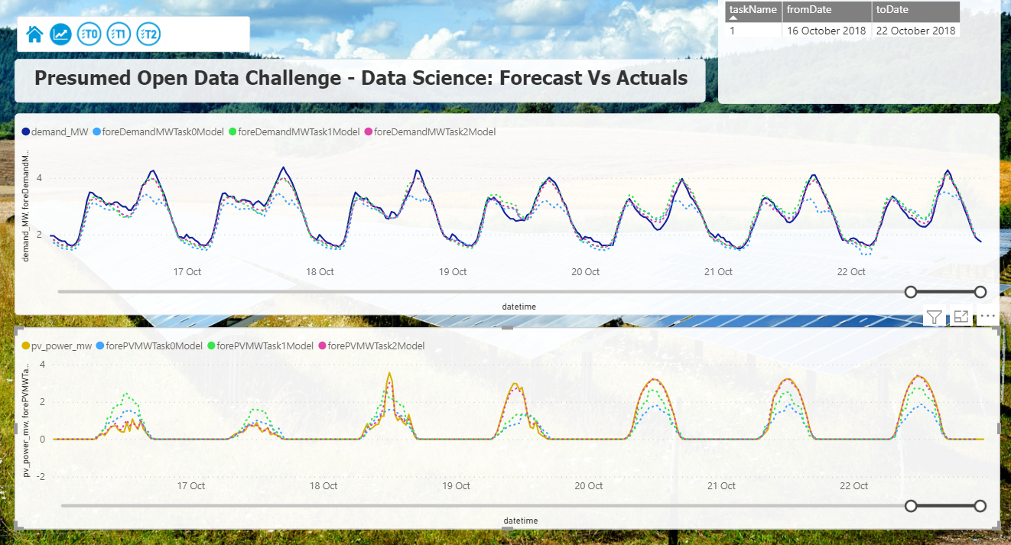
Forecast Model Back Test Comparison – Task 1 Week
Big Variations for Task 1 forecast period from the different forecast models
Latest Solar Model seems a much better fit for Task 1 data
All models under forecast peak demand slightly for Task 1

Slide 38
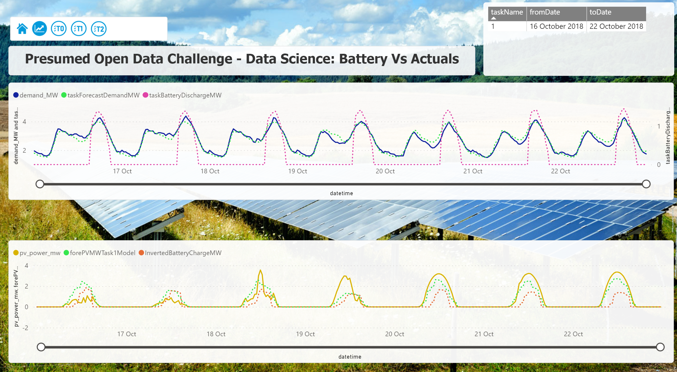
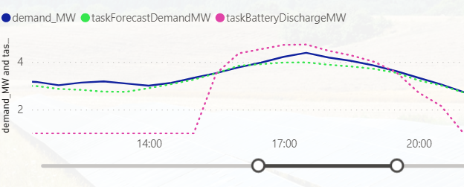

Battery Schedule vs Actual PV / Demand
Battery Schedule Task 1 vs Actual PV and Actual Demand
Over forecast of PV peaks leads to charge from grid
Under use of solar in ramping hours
Demand peaks are smoothed in forecast, meaning we could have more peak reduction
Smoothing of forecast demand peak, reduces peak reduction
Over forecast of PV peak leads to Charging from Grid
Under use of PV in early hours

Slide 39

Task 2 Battery Optimisation V3 – Optimise by Hand Run 1

Slide 40

Task 2 Battery Optimisation V3 – Optimise by Hand Run 2
Less use of PV over peak hours, which may be impacted by un- forecast cloud cover
More use of PV in early hours

Slide 41

Task 3 Battery Optimisation V3 – Optimise by Hand Run 3
Optimisation reflects probability of under forecasting peaks via new Peak Risk Factor

Slide 42
Task 2 Results
Significant improvement, placed 3rd for task 2 and up to 16th overall

Slide 43
Task 3
2019-12-18 to 2019-12-24

Slide 44


Solar Forecast Model V4
Addition of Azure function to automate forecast model execution makes it easier to compare results from different models

Slide 45


Demand Forecast Model 4

Slide 46


Special Day Christmas Eve (24 Dec)
On review of historic data, team decided to trust the model for 24th December and not use any special logic to adjust the model forecast

Slide 47

Task 3 Battery Optimisation V3 – Optimise by Hand Run 1
Uses a mix of Task 3 and Task 4 forecast models (takes max demand and max solar forecast)
Very short solar supply – just spread charging across daylight hours and hope to get some solar
No special day logic applied for 24 Dec yet

Slide 48

Task 3 Battery Optimisation V3 – Optimise by Hand Run 3
Battery Charging profile flattened
Demand Risk Factors Refined

Slide 49

Task 3 Battery Optimisation V3 – vs Actuals
Chagring from PV nearly optimal for most days, except day 3
Demand peak consistently over forecast (contrary to earlier tasks and use of risk factor)

Slide 50
Task 3 Results
Scores very close amongst top teams for Task 3
Overall improvement in position from 16th to 15th

Slide 51
Task 4
2020-07-03 to 2020-07-09

Slide 52


Solar Forecast Model V5

Slide 53


Demand Forecast Model V5

Slide 54

Demand Forecast – COVID impact
Peak demand shifted earlier in day during 2020, expected due to COVID impact on residential demand via Working From Home
Model back tested for week in June – appears to have picked up the shift in time of peak.

Slide 55

Task 4 Battery Optimisation Run 1

Slide 56
Next Steps
Forecast Model Tunning:
Active Data Cleaning [DONE]
Machine Learning Bespoke Tuning
Adding Bearings to Weather Station Information
Data Processing Automation:
Automate Task Data Setup [IN PROGRESS]
Forecast creation automation[DONE]
Optimisation Model Improvements:
Move into Optimisation Solver [NOT DOING]
Strategy for solar ramping periods [DONE]
Remove solar ramping period strategy and focus on using low levels of solar throughout day [DONE]
New Strategy for Demand Peak Under forecast [DONE]
Special Day Strategy for 24 Dec [NOT DOING]
Separate strategy for low and high solar days [DONE]
Automate optimiser [IN PROGRESS]

Slide 57
Appendix 1 – Architecture Research

Slide 58


Azure Architecture Templates

Slide 59


AWS Architecture Templates
Python Optimisation

